Slide 1

The PPPP of residential energy efficiency
in Eastern Europe

Slide 2

Regional context
Much of the existing housing stock dates back to 1960s
Mostly pre-fabricated multi-story apartment buildings -in some countries representing 30% in some more than 70%
After the privatization of 1990, 90%+ of dwellings are privately owned
Residential heating accounts for more than 40 % of energy use
Utilities are subsidized by the government
Estimated energy savings potential of energy efficiency measures in residential buildings range between 20-40%

Slide 3

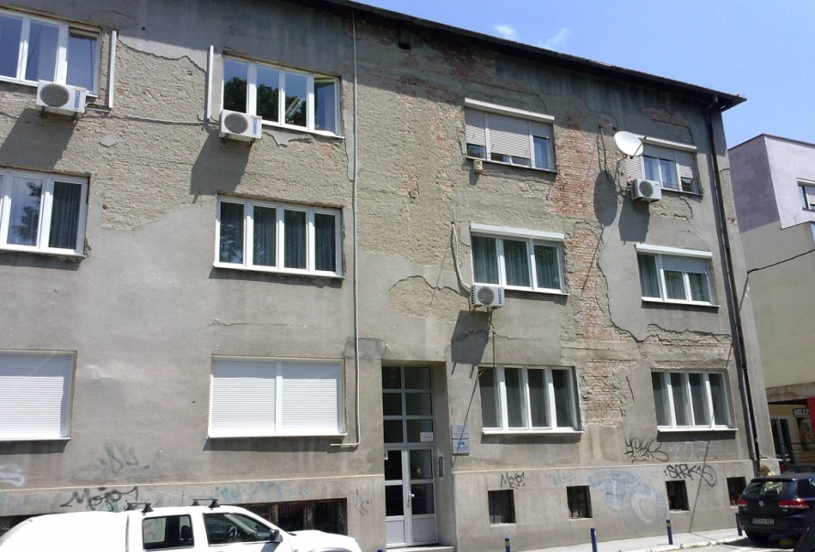
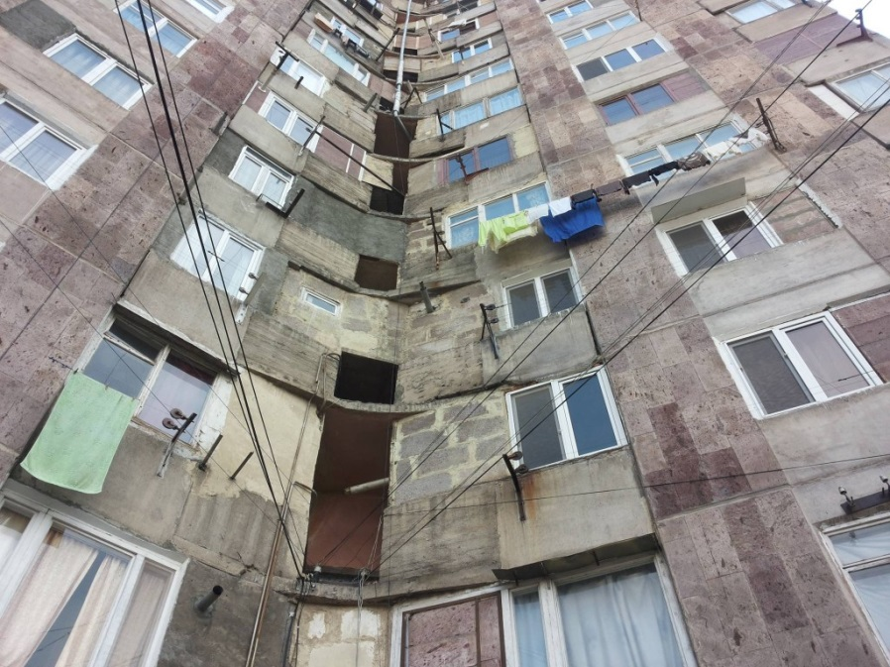
Habitat’s EE portfolio in the Balkans and in Eastern Europe
Armenia
Bosnia and Hercegovina
Macedonia
Poland
Bulgaria

Slide 4
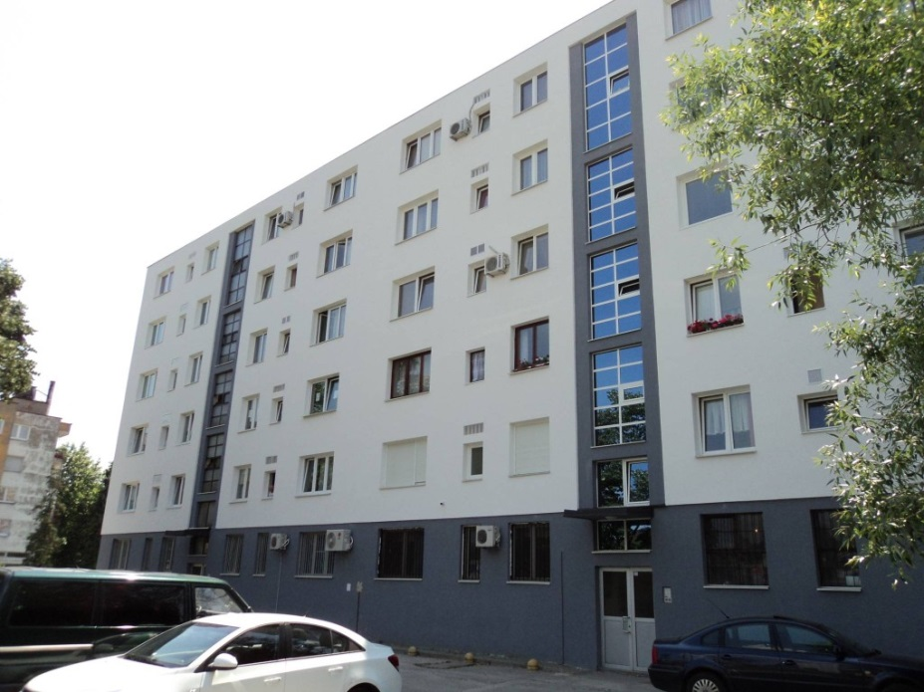
Benefits
There are multiple benefits to investing in energy efficiency. A particular cost effective investment is in the common spaces of apartment buildings such as facades, roofs, stairwells, basements etc.
Examples of benefits:
Direct savings on the heating bill
Beautification of the building or city image
Increased comfort at home
Real estate value increase
Safer living environment
Healthier living conditions
Reduced green house gas emissions

Slide 5
Challenges
If the benefits are so many, why aren’t we all investing in residential energy efficiency?
Typical challenges:
Ownership structure: in many countries in Eastern Europe and Central Asia individual apartment ownership is > 90%
History: home owners reluctant to take responsibility for common space maintenance
Access to financing for HOA’s or common space investments (guarantees)
Trust: HO’s ⬄ HOA’s, HO’s ⬄ HO’s, Banks ⬄ HO’s, Banks ⬄ HOA’s

Slide 6
Expected outcomes
Overall outcome: reduce energy poverty in Eastern Europe
1 Convinced home-owners in Eastern Europe about EE and empowered home-owner associations (HOAs)
2: Mix of financing mechanisms (credit lines for HOAs and subsidies for vulnerable customers) are introduced on scale
3: Facilitation of stakeholders is acknowledged as critical and subsidising it becomes integral part of project financing

Slide 7
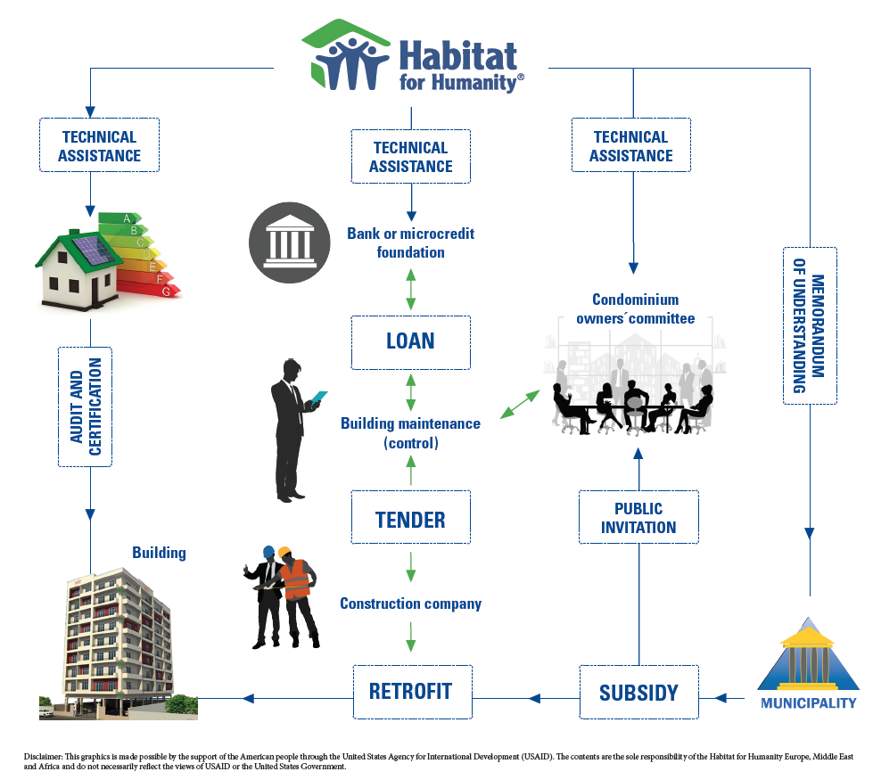
The PPPP process flow

Slide 8
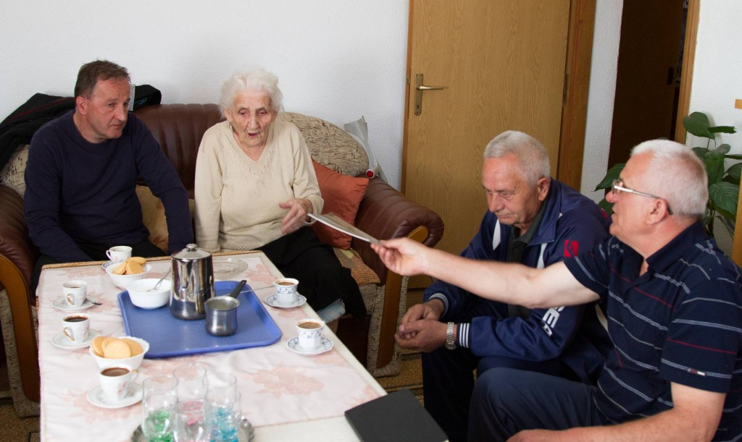
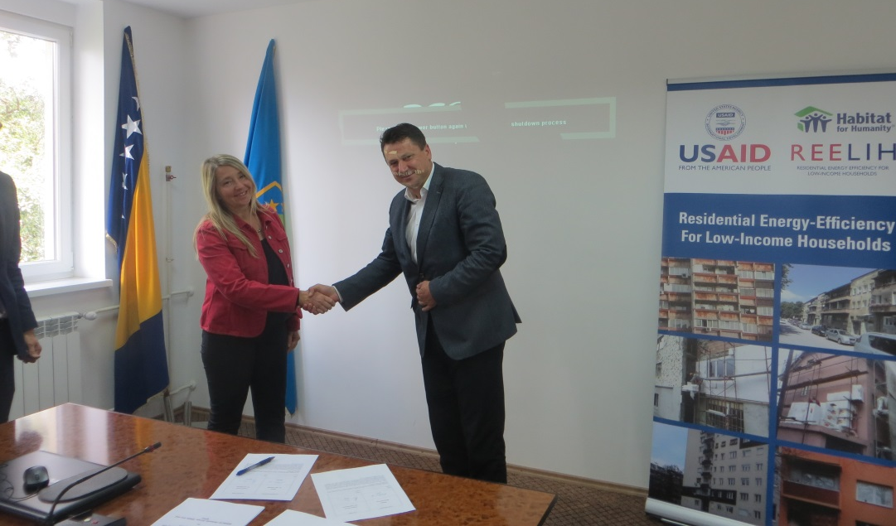
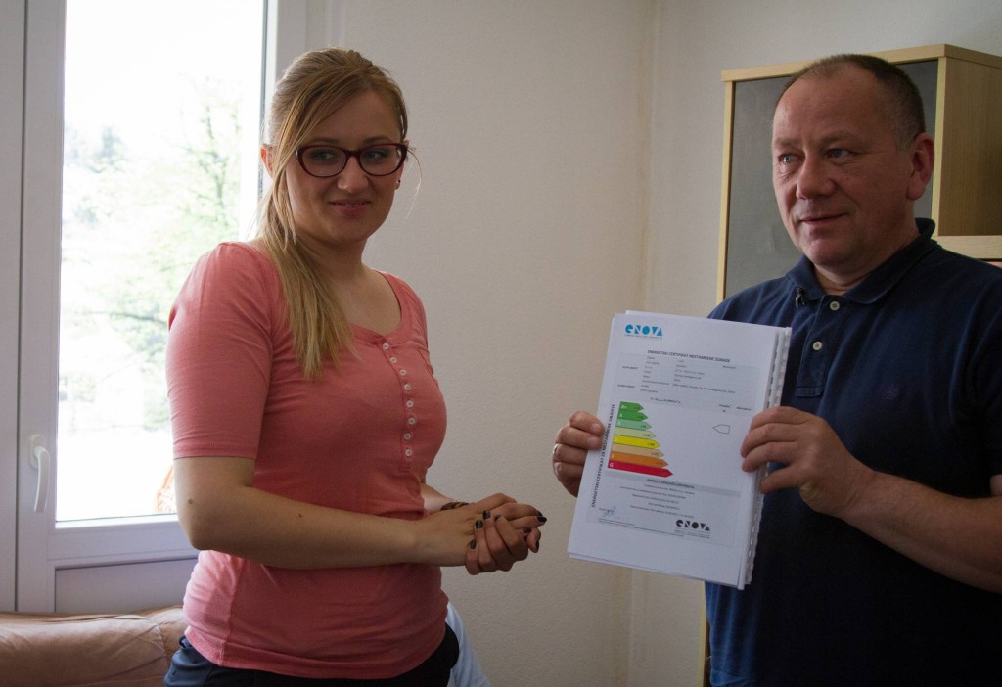
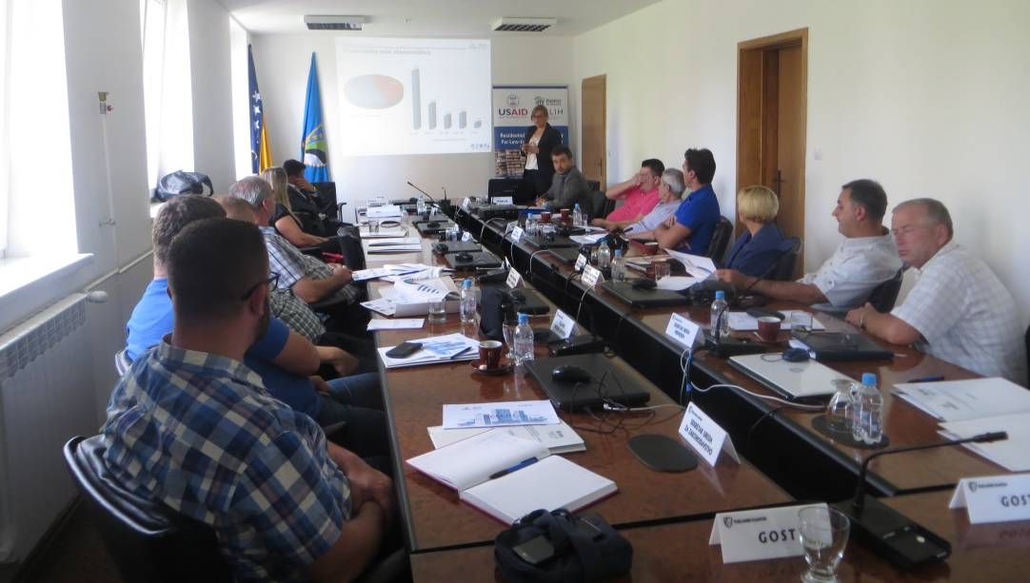

Slide 9
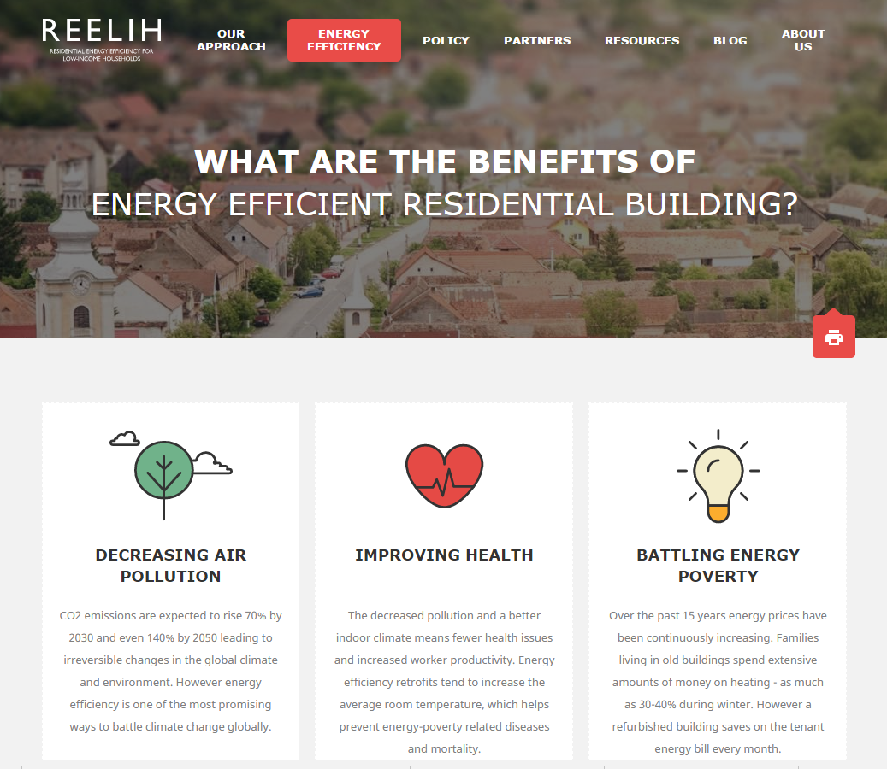
REELIH project
Results:
“Draft” models tested in Armenia and Bosnia & Herzegovina
3 buildings in Armenia and 4 in Bosnia & Herzegovina renovated
Regional and national level research on REE institutional context
Knowledge sharing platform
Policy recommendations

Slide 10
Conclusions
For investments in residential energy efficiency to become sustainable we need to understand the motivations of the individual home owners and the dynamics of their interaction in the home owners association.
Providing financing alone is insufficient, be it subsidies or loan products, to initiate action by home owners or their associations.
Without the home owners reaching an agreement, nothing will happen in their common spaces. Therefore, we need to:
Strengthen HOA self governance capacity
Establish HOA’s reputation as a trustworthy borrower
Create a supportive institutional environment for HOA’s to function
And we need on-going facilitation between stakeholders to make it a real PPPP!

